Slide 1
Introduction to Data Analytics
Day 7-Regression

Slide 2
Hypothesis recap
Research Question 1: Does a new teaching method improve student performance in mathematics?
Research Question 2: Does caffeine consumption affect reaction time?
What is dependent and independent Variable
Null hypothesis
Alternate Hypothesis

Slide 3
Correlation and regression
Correlation (R) shows the relationship between the two variables, while regression allows us to see how one affects the other.
• if the two variables are related it means that when one changes by a certain amount the other changes on an average by a certain amount.
• If y represents the dependent variable and x the independent variable, this relationship is described as the regression of y on x.
• In this context “regression” simply means that the average value of y is a “function” of x, that is, it changes with x.

Slide 4
Linear regression
Linear regression is a statistical method used to model the relationship between a dependent variable and one or more independent variables by fitting a linear equation to observed data. The basic form of a linear regression equation is:
y=a+bx
Where:
Y is the dependent variable (the variable you want to predict).
X is the independent variable (the variable you use to make predictions).
a is the intercept (the value of Y when X is 0).
b is the slope of the line (the effect that X has on Y).

Slide 5
Regression •
Regression is the analysis of the relation between one variable and some other variable(s), assuming a linear relation. Also referred to as least squares regression and ordinary least squares (OLS)
For example, suppose the cost for a small pizza at a restaurant if KES 500 plus KES.50 per topping. If we let x = # of topings and y = $ of pizza, then 𝑦 = 500 + 50𝑥. If we order a 3-topping pizza, then 𝑦 = 500 + 50(3) = 650

Slide 6
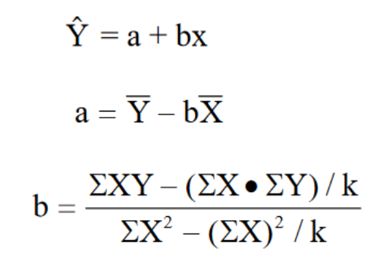
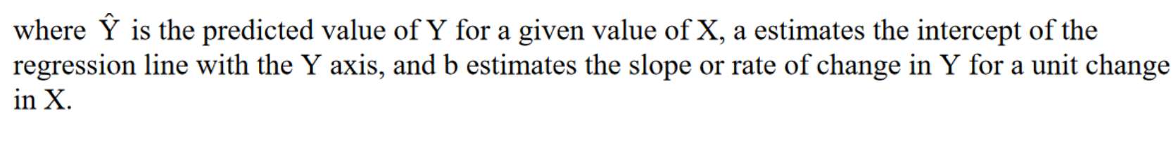
Linear regression

Slide 7
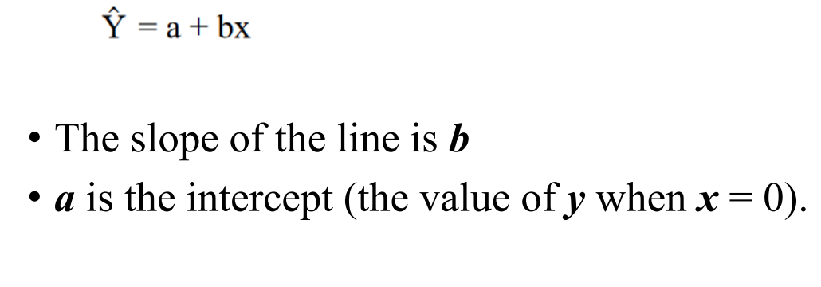
Regression parameters

Slide 8
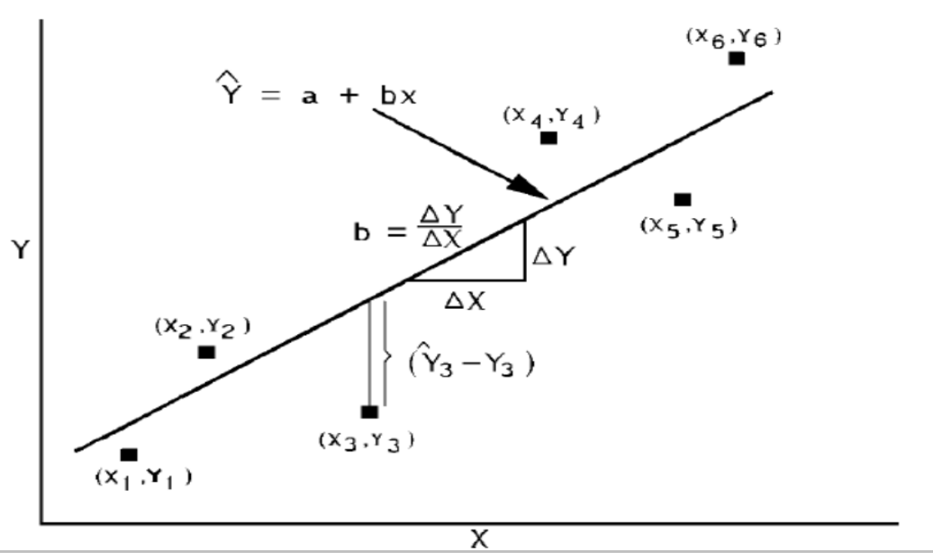
Scatter diagram

Slide 9
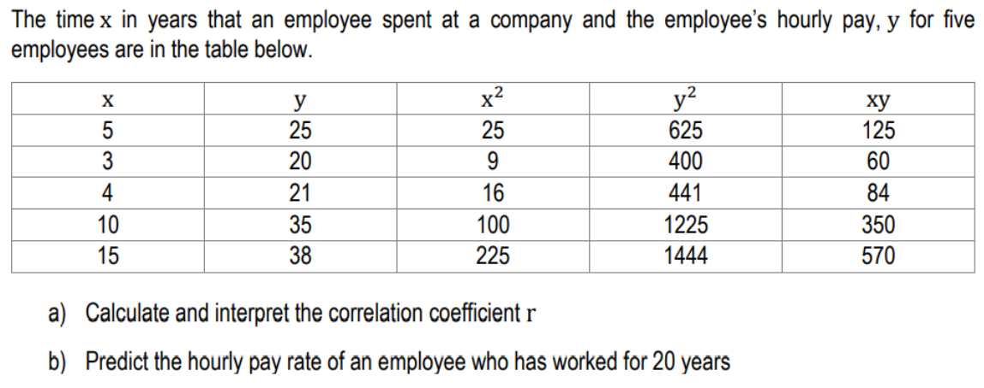
Example 1

Slide 10
Application of linear regression
Marketing and Sales:
Predicting sales revenue based on advertising spending across different channels.
Analyzing customer behavior to optimize marketing strategies.
Healthcare:
Predicting patient outcomes based on medical history and demographics.
Analyzing the impact of lifestyle factors on health outcomes.
Environmental Science:
Predicting pollution levels based on meteorological factors.
Analyzing the impact of climate change on biodiversity.

Slide 11
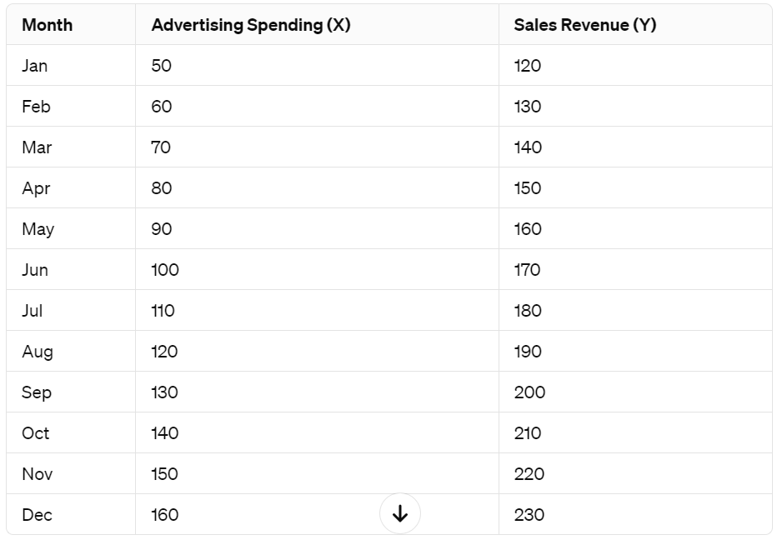
Exercise. Obtain regression line

